Slide 1


Kolhapur Institute of Technology’s College of Engineering, Kolhapur
(An Autonomous Institute Accredited ‘A’ grade by NAAC with CGPA 3.12)
Department of Computer Science and Engineering
Class: TY_CSE_B Course: Database Engineering
Project Based Learning Taxi Management System
Group 04
VINAYAK PRAKASH MALI
PHATAK OM SANJAY
GHATE OMKAR TUKARAM
BANDARKAR SHANTANU SHIRISH
Guided By
MR. J. S. PUJARI
[B_08]
[B_04]
[B_19]
[B_20]

Slide 2
Roadmap
Problem Statement &
Objective
Functions & Features
Future Scope
& Conclusion
1
3
5
2
4
6
Work Flow
ER & Class Diagram
Live Working of Taxi Management System

Slide 3

Problem Statement
To develop an online application to book taxi/cabs efficiently, easily, and to maintain a record of the trip details for future reference.

Slide 4
Objectives
To automate vehicle rental and reservation.
To facilitate easy and efficient booking of trips.
To maintain an effective database to create, read, update, and delete data efficiently.

Slide 5
Features
Ideal Admin Panel
Effortless Signup Process
User-Centric Booking Process
Complete Booking History for User as well as Driver
Single Login at a time for security
Instant Update Acceptance Status

Slide 6
User Flow Diagram
Home Page
Sign Up
Login
Admin Login
Sign Up as User
Sign Up as Driver
Sign In as User
Sign In as Driver
Admin Panel
User Query
Book Trip
Accept Trip
Driver Query
History
History
Trip Query
Custom Query

Slide 7
Functions & Features
Registration
Effortless Registration Process
Login
Single Login at a time for Security
R
L
Accepting Trip from Available Trips
Printing history in any format
Accepting Trip
User-Centric Booking Process
Booking Trip
A
B

Slide 8
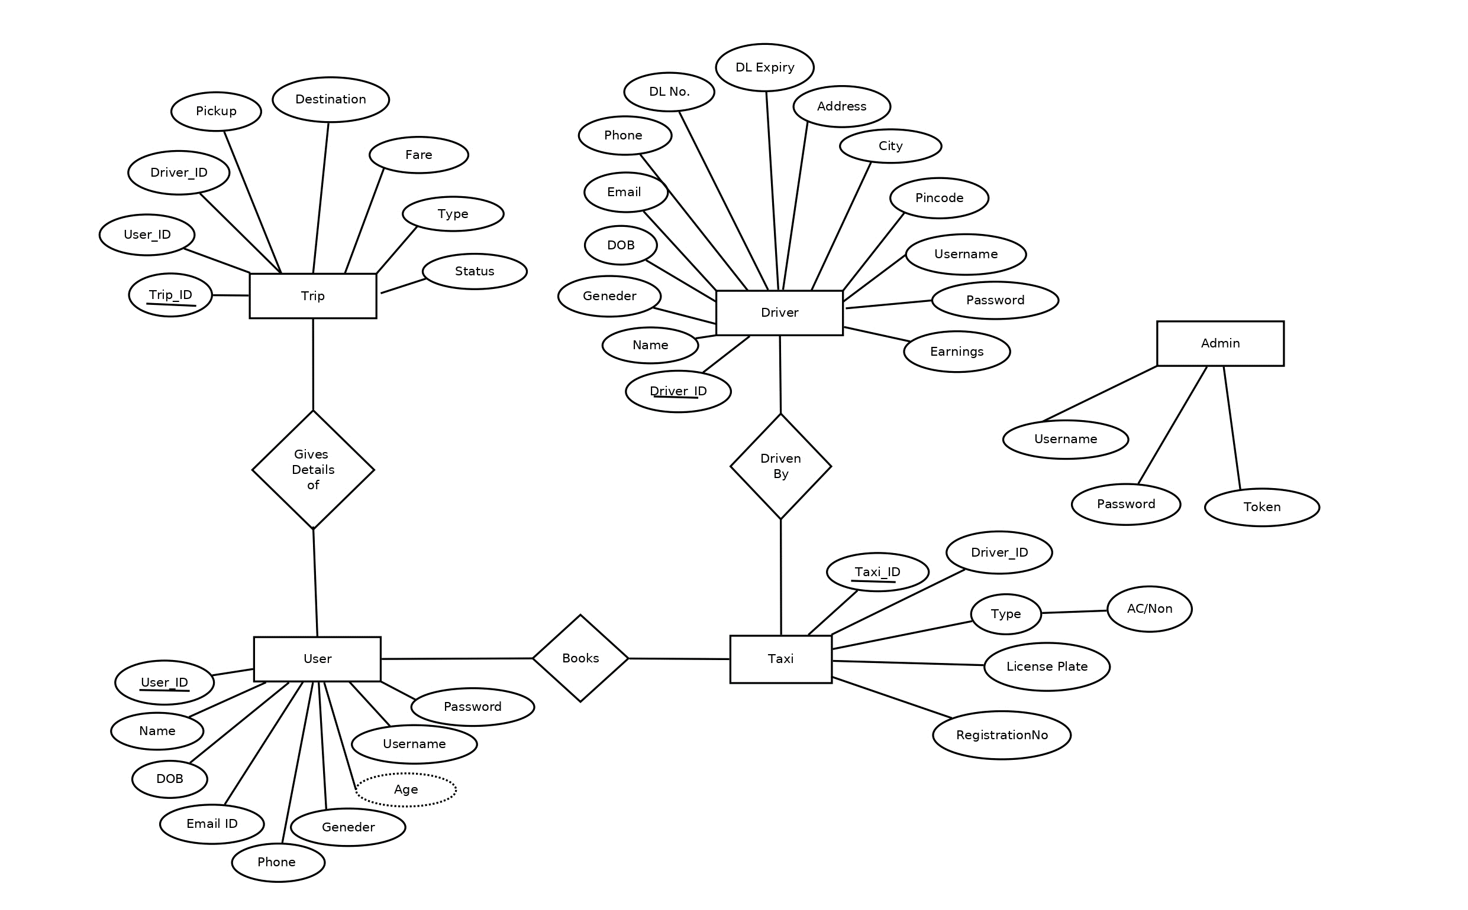
ER Diagram

Slide 9
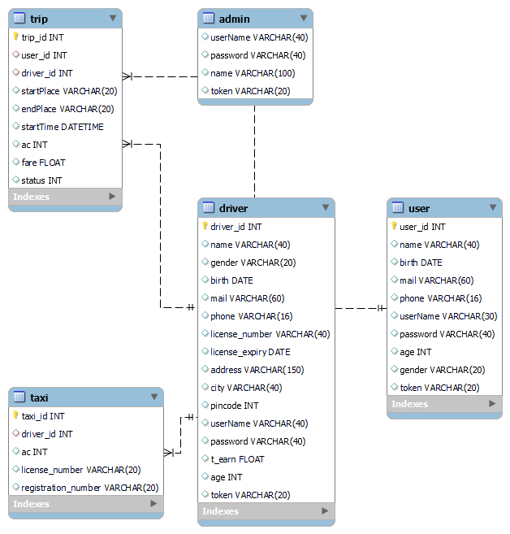
Class Diagram

Slide 10

Future scope
Live Tracking of Taxi
Exact Co-ordinates while booking trip
User Feedback & Rating
Online Payment Option
Taxi Pooling

Slide 11
Conclusion

Slide 12
Work Flow
Sr. No. | Database Implementation Procedure | Timeline
1 | Problem Identification | August last week
2 | Synopsis | Sept 1st week
3 | Preparation of SRS | Sept 3rd Week
4 | Design of ER Model and Schema | Sept 4th Week
5 | Design and development of Database | October 1st Week
6 | Review of Database Design | October 4th Week
7 | Design of UI | November 2nd Week
8 | Final integration of UI and Database | November 4th Week

Slide 13
References
Node.js - https://nodejs.org/en/docs
Express.js - https://expressjs.com/
JavaTPoint – https://javatpoint.com
MySQL - https://dev.mysql.com/doc
Bootstrap Studio – https://getbootstrap.com/docs

Slide 14
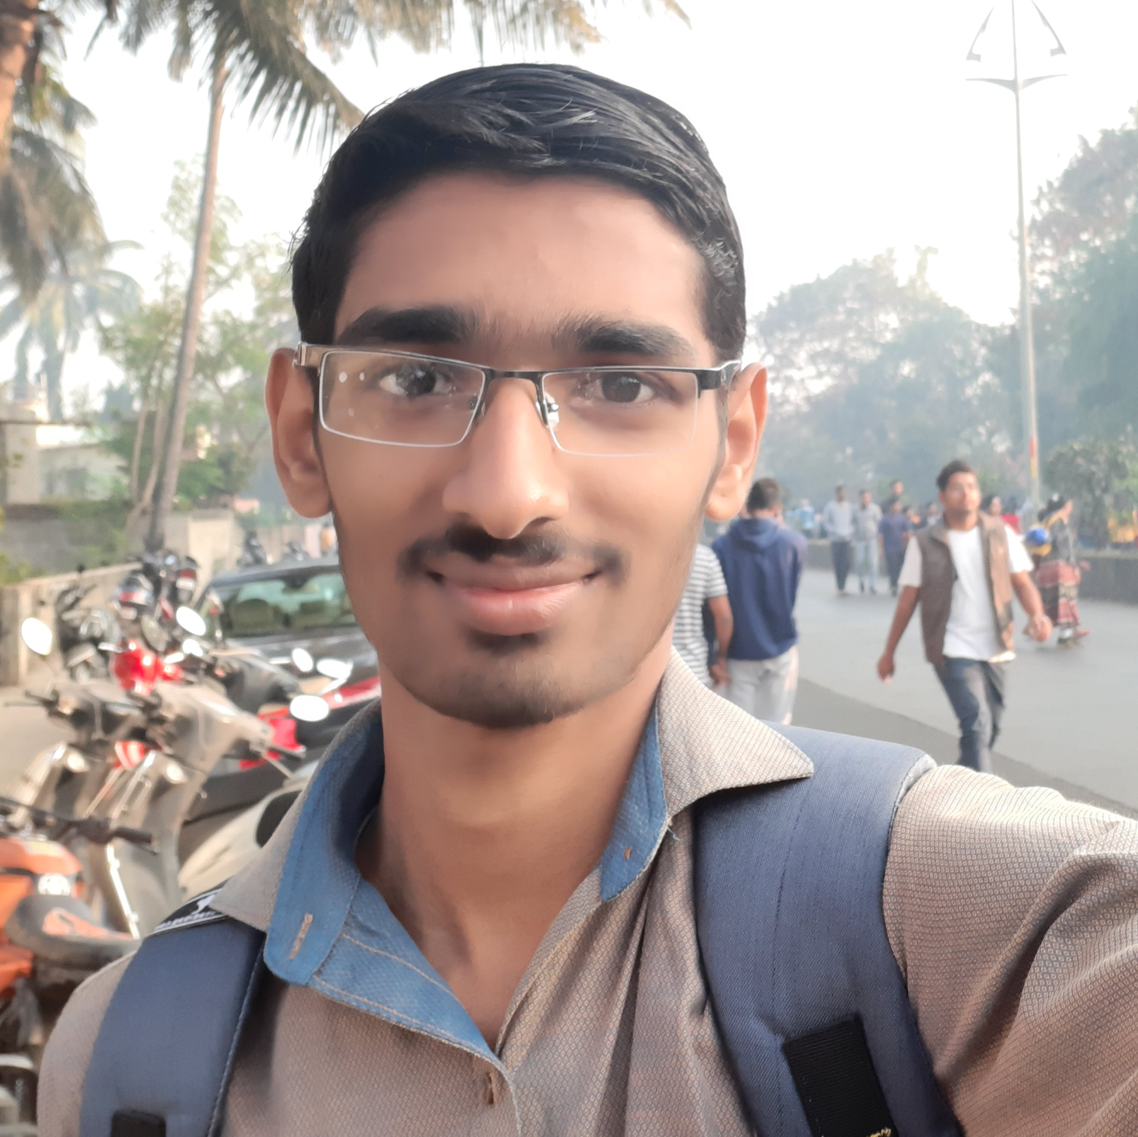



Team
Vinayak Mali Om Phatak Shantanu Bandarkar Omkar Ghate

Slide 15
THANK YOU!
Any questions?

